Slide 1






Dictionaries, Nested Dictionaries, Lambda & LINQ
Using Dictionaries &Nested Dictionaries, Manipulating Collections with LINQ
Programming Fundamentals
SoftUni Team
Technical Trainers
Software University
http://softuni.bg

Slide 2
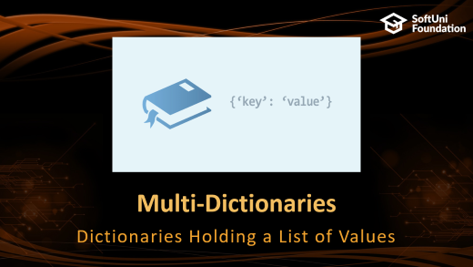
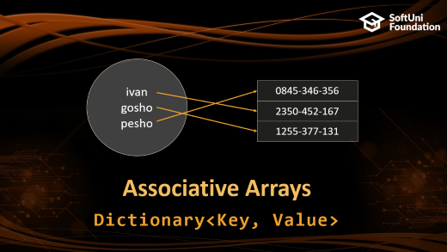

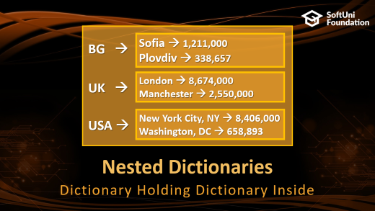
Table of Contents

Slide 3
Have a Question?
sli.do #extended-softuni

Slide 4
Associative Arrays
ivan
gosho
pesho
0845-346-356
2350-452-167
1255-377-131
Dictionary<Key, Value>

Slide 5
Associative Arrays (Maps, Dictionaries)
Associative arrays are arrays indexed by keys
Not by the numbers 0, 1, 2, … (like traditional arrays)
Hold a set of pairs {key → value}
Traditional array
Associative array
key
value
key
0 1 2 3 4
John Smith | +1-555-8976
Lisa Smith | +1-555-1234
Sam Doe | +1-555-5030
value
8 | -3 | 12 | 408 | 33

Slide 6
Dictionary Example – Phonebook
var phonebook = new Dictionary<string, string>();
phonebook["John Smith"] = "+1-555-8976"; phonebook["Lisa Smith"] = "+1-555-1234";
phonebook["Sam Doe"] = "+1-555-5030";
phonebook["Nakov"] = "+359-899-555-592";
phonebook["Nakov"] = "+359-2-981-9819"; // Replace
phonebook.Remove("John Smith");
foreach (var pair in phonebook)
Console.WriteLine("{0} --> {1}",
pair.Key, pair.Value);

Slide 7

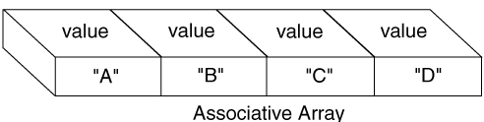
Dictionary<K, V> vs. SortedDictionary<K, V>
Traditional dictionaries
Uses a hash-table + list
Dictionary<K, V>
Keep the keys in their order of addition
var dict =
new Dictionary<string, int>();

Slide 8
Dictionaries: Functionality
Count – holds the number of key-value pairs
Keys – a set of unique keys
Values – a collection of all values
Basic operations: Add() / indexer [], Remove(), Clear()
var dict = new Dictionary<string, int>();
foreach(var key in dict.Keys)
Console.WriteLine(key);
Console.WriteLine(String.Join(", ", dict.Values));

Slide 9
Dictionaries: Functionality (2)
Find key / value:
ContainsKey() – checks if a key is present in the dictionary (fast operation)
ContainsValue() – checks if a value is present in the dictionary (slow operation)
TryGetValue() – check if a key is present in the dictionary and ouputs the value (or returns the default value)

Slide 10

Traditional Dictionary: Add()
Dictionary<string, string>
Pesho
0881-123-987
Gosho
0881-123-789
Alice
0881-123-978
Hash Function
Key Value

Slide 11
Dictionary: Remove()
Dictionary<string, string>
Pesho
Pesho
0881-123-987
Gosho
0881-123-789
Hash Function
Alice
0881-123-978
Key Value

Slide 12
Iterating through Dictionaries
foreach loop
KeyValuePair<string, string> keyValuePair in
Dictionary<string, string>
Pesho
Pesho
0881-123-987
0881-123-987
Gosho
Gosho
0881-456-987
0881-456-987
Alice
+359-899-55-592
Alice
+359-899-55-592
.Key .Value
Notes:
foreach (KeyValuePair<string, int> keyValuePair in phonebook)
{
Console.WriteLine("name: {0}, mobile number: {1}",
keyValuePair.Key,
keyValuePair.Value);
}

Slide 13
Problem: Odd Occurrences
Write a program to extract from given sequence of words all elements that present in it odd number of times (case-insensitive)
Words are given in a single line, space separated
Print the result elements in lowercase, in their order of appearance
Java C# PHP PHP JAVA C java
java, c#, c
3 5 5 hi pi HO Hi 5 ho 3 hi pi
5, hi
a a A SQL xx a xx a A a XX c
a, sql, xx, c
Check your solution here: https://judge.softuni.bg/Contests/Practice/Index/865#0

Slide 14
Solution: Odd Occurrences
string input = Console.ReadLine().ToLower();
string[] words = input.Split(' ');
var counts = new Dictionary<string, int>();
foreach (var word in words)
if (counts.ContainsKey(word))
counts[word]++;
else counts[word] = 1;
var results = new List<string>();
foreach (var pair in counts)
// TODO: add pair.Key to results if pair.Value is odd
Console.WriteLine(string.Join(", ", results));
counts[word] holds how many times word occurs in words
Check your solution here: https://judge.softuni.bg/Contests/Practice/Index/865#0

Slide 15

Associative Arrays
Live Exercises in Class

Slide 16
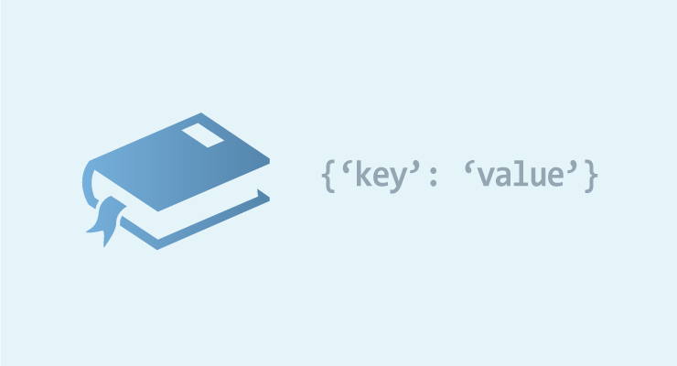
Multi-Dictionaries
Dictionaries Holding a List of Values

Slide 17
Multi-Dictionaries
A dictionary could hold a set of values by given key
Example: students may have multiple grades:
Peter → [5, 5, 6]
Kiril → [6, 6, 3, 4, 6]
Dictionary<string, List<int>> grades;
Key → String
Value → List<int>

Slide 18
Example: Student Grades
Each student has a list of grades
We can access the student’s grades by name:
Value → List<int>
var grades = new Dictionary<string, List<int>>();
grades["Peter"] = new List<int>();
grades["Peter"].Add(5);
grades["Peter"].Add(5);
grades["Peter"].Add(6);
var kirilGrades = new List<int>() { 6, 6, 3, 4, 6 };
grades["Kiril"] = kirilGrades;
Console.WriteLine(string.Join(" ", grades["Kiril"]); // 6 6 3 4 6
Initialize the list
Accessing list by key (Peter)
Assigning list to key

Slide 19
Problem: Average Student Grades
Write a program to read student names + grades
Print the grades + average grade for each student as shown below
7
Ivancho 5.20
Mariika 5.50
Ivancho 3.20
Mariika 2.50
Stamat 2.00
Mariika 3.46
Stamat 3.00
Ivancho -> 5.20 3.20 (avg: 4.20)
Mariika -> 5.50 2.50 3.46 (avg: 3.82)
Stamat -> 2.00 3.00 (avg: 2.50)

Slide 20
Solution: Average Student Grades (1)
var grades = new Dictionary<string, List<double>>();
var n = int.Parse(Console.ReadLine());
for (int i = 0; i < n; i++)
{
var tokens = Console.ReadLine().Split();
var name = tokens[0];
var grade = double.Parse(tokens[1]);
if (!grades.ContainsKey(name))
grades[name] = new List<double>();
grades[name].Add(grade);
}
// continued on next slide ...
Make sure the list is initialized
Add grade into list

Slide 21
Solution: Average Student Grades (2)
KeyValuePair<string, List<double>
foreach (var pair in grades)
{
var name = pair.Key;
var studentGrades = pair.Value;
var average = studentGrades.Average();
Console.Write($"{name} -> ");
foreach (var grade in studentGrades)
Console.Write($"{grade:f2} ");
Console.WriteLine($"(avg: {average:f2})");
}
Key: string
Value: List<string>
Average value of the list

Slide 22
Nested Dictionaries
BG →
UK →
USA →
Sofia → 1,211,000
Plovdiv → 338,657
London → 8,674,000
Manchester → 2,550,000
New York City, NY → 8,406,000
Washington, DC → 658,893
Dictionary Holding Dictionary Inside

Slide 23
Nested Dictionaries
Dictionaries may hold another Dictionary<K,V> as value
Example: population by country and city
Value: Dictionary <string, int>
BG →
UK →
USA →
Sofia → 1,211,000
Plovdiv → 338,657
Key: string
London → 8,674,000
Manchester → 2,550,000
New York City, NY → 8,406,000
Washington, DC → 658,893

Slide 24
Problem: Cities by Continent and Country
Write a program to read continents, countries and their cities, put them in a nested dictionary and print them
9
Europe Bulgaria Sofia
Asia China Beijing
Asia Japan Tokyo
Europe Poland Warsaw
Europe Germany Berlin
Europe Poland Poznan
Europe Bulgaria Plovdiv
Africa Nigeria Abuja
Asia China Shanghai
Europe:
Bulgaria -> Sofia, Plovdiv
Poland -> Warsaw, Poznan
Germany -> Berlin
Asia:
China -> Beijing, Shanghai
Africa:
Nigeria -> Abuja

Slide 25
Solution: Cities by Continent and Country (1)
var continentsData = new Dictionary<string, Dictionary<string, List<string>>>();
var n = int.Parse(Console.ReadLine());
for (int i = 0; i < n; i++)
{
var tokens = Console.ReadLine().Split();
var continent = tokens[0];
var country = tokens[1];
var city = tokens[2];
// continued on next slide
Initialize the dictionary

Slide 26
Solution: Cities by Continent and Country (2)
Continent doesn’t exist → create it
if (!continentsData.ContainsKey(continent))
continentsData[continent] =
new Dictionary<string, List<string>>();
if (!continentsData[continent].ContainsKey(country))
continentsData[continent][country] = new List<string>();
continentsData[continent][country].Add(city);
}
// continued on next slide...
Country doesn’t exist
Initialize cities
Append a city to the country

Slide 27
Solution: Cities by Continent and Country (3)
foreach (var continentCountries in continentsData)
{
var continentName = continentCountries.Key;
var countries = continentCountries.Value;
Console.WriteLine($"{continentName}:");
foreach (var countryCities in countries)
{
var countryName = countryCities.Key;
var cities = countryCities.Value;
Console.WriteLine(" {0} -> {1}",
countryName, string.Join(", ", cities));
}
}
Continent name
Countries in the continent
Country name
Cities in the country

Slide 28
Multi and Nested Dictionaries
Exercises in Class

Slide 29

Lambda Functions and LINQ
f(x) → y
LINQ
LINQ in Action: Filtering, Mapping, Ordering

Slide 30
What is LINQ?
LINQ == Language INtegrated Query
Dramatically simplifies collection processing
List<int> nums = new List<int>() { 2, 4, 3, 1 };
var sum = nums.Sum(); // 10
var min = nums.Min(); // 1
var avg = nums.Average(); // 2.5
var bigNums = nums.Where(a => a > 2).ToList(); // {4, 3}
var reversed = nums.Reverse().ToList(); // { 1, 3, 4, 2 }

Slide 31
Processing Sequences with LINQ
Min() – finds the smallest element in a collection
Max() – finds the largest element in a collection
Sum() – finds the sum of all elements in a collection
Average() – finds the average of all elements in a collection
new List<int>() { 1, 2, 3, 4, -1, -5, 0, 50 }.Min() → -5
new int[] { 1, 2, 3, 40, -1, -5, 0, 5 }.Max() → 40
new long[] {1, 2, 3, 4, -1, -5, 0, 50}.Sum() → 54
new int[] {1, 2, 3, 4, -1, -5, 0, 50}.Average() → 6.75

Slide 32
Problem: Sum, Min, Max, Average
Write a program to read n integers and print their sum, min, max and average values:
5
12
20
-5
37
8
Sum = 72
Min = -5
Max = 37
Average = 14.4
4
50
20
25
40
Sum = 135
Min = 20
Max = 50
Average = 33.75
Check your solution here: https://judge.softuni.bg/Contests/Practice/Index/434#0

Slide 33
Solution: Sum, Min, Max, Average
Use System.Linq to enable LINQ functions like .Max() and .Sum()
using System.Linq;
…
int n = int.Parse(Console.ReadLine());
int[] nums = new int[n];
for (int i = 0; i < n; i++)
nums[i] = int.Parse(Console.ReadLine());
Console.WriteLine("Sum = {0}", nums.Sum());
Console.WriteLine("Min = {0}", nums.Min());
// TODO: print also max and average values
Check your solution here: https://judge.softuni.bg/Contests/Practice/Index/434#0

Slide 34
Reading Collections on a Single Line
Using Select() to read collections:
var nums = Console.ReadLine()
.Split()
.Select(number => double.Parse(number));
// .Select(double.Parse);
var nums = Console.ReadLine()
.Split()
.Select(int.Parse);
// .Select(number => int.Parse(number));

Slide 35
Converting Collections
Using ToArray(), ToList() to convert collections:
int[] nums = Console.ReadLine()
.Split()
.Select(number => int.Parse(number))
.ToArray();
List<double> nums = Console.ReadLine()
.Split()
.Select(double.Parse)
.ToList();

Slide 36
Sorting Collections
Using OrderBy() to sort collections:
Using OrderByDescending() to sort collections:
List<int> nums = { 1, 5, 2, 4, 3 };
nums = nums
.OrderBy(num => num)
.ToList()
List<int> nums = { 1, 5, 2, 4, 3 };
nums = nums
.OrderByDescending(num => num)
.ToList()

Slide 37
Sorting Collections by Multiple Criteria
Using ThenBy() to sort collections by multiple criteria:
Dictionary<int, string> products =
new Dictionary<int, string>();
Dictionary<int, string> sortedDict = products
.OrderBy(pair => pair.Value)
.ThenBy(pair => pair.Key)
.ToDictionary(pair => pair.Key, pair => pair.Value);

Slide 38
Take / Skip Elements from Collection
Using Take(), Skip():
var nums = new List<int>() { 10, 20, 30, 40, 50, 60}
.Take(3)
.ToArray();
// nums = [10, 20, 30]
var nums = new List<int>() { 10, 20, 30, 40, 50, 60}
.Skip(3).Take(2)
.ToArray();
// nums = [40, 30]

Slide 39
Problem: Largest 3 Numbers
Read a list of real numbers and print largest 3 of them
10 30 15 20 50 5
50 30 20
20 30
30 20
0 -5 -1 -3 -2
0 -1 -2
Check your solution here: https://judge.softuni.bg/Contests/Practice/Index/865#4

Slide 40
Solution: Largest 3 Numbers
List<int> nums = Console.ReadLine().Split()
.Select(int.Parse)
.ToList();
var sortedNums = nums.OrderByDescending(x => x);
var largest3Nums = sortedNums.Take(3);
Console.WriteLine(string.Join(" ", largest3Nums));
Check your solution here: https://judge.softuni.bg/Contests/Practice/Index/865#4

Slide 41
Lambda Expressions
A lambda expression is an anonymous function containing expressions and statements
Lambda expressions
Use the lambda operator =>
Read as "goes to"
The left side specifies the input parameters
The right side holds the expression or statement
var lambda = (a => a > 5);

Slide 42
Filter Collections
Using Where(), Count():
int[] nums = { 1, 2, 3, 4, 5, 6};
nums = nums
.Where(num => num % 2 == 0)
.ToArray();
// nums = [2, 4, 6]
int[] nums = { 1, 2, 3, 4, 5, 6};
int count = nums.Count(num => num % 2 == 0);
// count = 3

Slide 43
Filtering and Sorting with Lambda Functions
int[] nums = { 11, 99, 33, 55, 77, 44, 66, 22, 88 };
nums.OrderBy(x => x).Take(3);
// 11 22 33
nums.Where(x => x < 50);
// 11 33 44 22
nums.Count(x => x % 2 == 1);
// 5
nums.Select(x => x * 2).Take(5);
// 22 198 66 110 154

Slide 44
Getting Unique Elements from Collection
We can use Distinct() to get the unique elements from a collection:
int[] nums =
{ 1, 2, 2, 3, 4, 5, 6, -2, 2, 0, 15, 3, 1, 0, 6 };
nums = nums
.Distinct()
.ToArray();
// nums = [1, 2, 3, 4, 5, 6, -2, 0, 15]

Slide 45
Take Single Element from Collection
Using First(), Last() , Single():
int[] nums = { 1, 2, 3, 4, 5, 6 };
int firstNum = nums.First(x => x % 2 == 0); // 1
int lastNum = nums.Last(x => x % 2 == 1); // 6
int singleNum = nums.Single(x => x == 4); // 4

Slide 46
Other Operations over Collections
Using Reverse()
Using Concat():
int[] nums = { 1, 2, 3, 4, 5, 6};
nums = nums.Reverse();
// nums = 6, 5, 4, 3, 2, 1
int[] nums = { 1, 2, 3, 4, 5, 6 };
int[] otherNums = { 7, 8, 9, 0 };
nums = nums.Concat(otherNums);
// nums = 1, 2, 3, 4, 5, 6, 7, 8, 9, 0

Slide 47


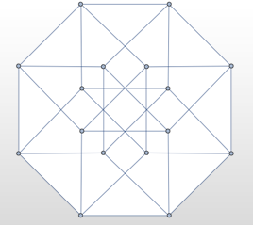

Summary
Associative Arrays
Arrays indexed by keys
Dictionaries
Are working with a Hash Table
Nested Dictionaries
Lambda Expressions
LINQ
Ordering collections
Filtering collections

Slide 48







Progr. Fund. Extended – Dictionaries & LINQ
https://softuni.bg/courses/programming-fundamentals

Slide 49
License
This course (slides, examples, demos, videos, homework, etc.) is licensed under the "Creative Commons Attribution-NonCommercial-ShareAlike 4.0 International" license

Slide 50





Trainings @ Software University (SoftUni)
Software University – High-Quality Education, Profession and Job for Software Developers
softuni.bg
Software University Foundation
http://softuni.foundation/
Software University @ Facebook
facebook.com/SoftwareUniversity
Software University Forums
forum.softuni.bg

